Slide 1
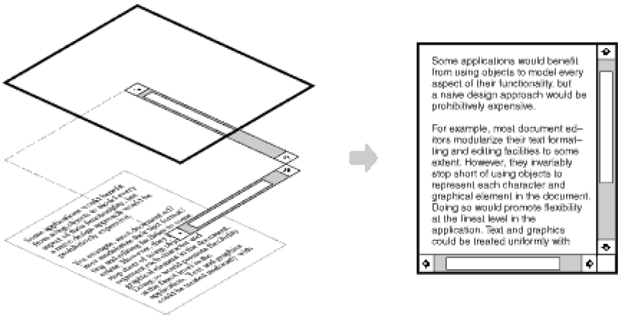
Pattern: Decorator

Slide 2
Decorator pattern
Objects that wrap around other objects to add useful features
Features are added to existing simple objects without needing to disrupt the interface that client code expects when using the simple object

Slide 3
Motivation
Want to add responsibilities / capabilities to individual objects, not to an entire class.
Inheritance requires a compile-time choice of parent class.

Slide 4
Solution
Enclose the component in another object that adds the responsibility/capability.
    The enclosing object is called a decorator.

Slide 5
Examples in Java
multilayered input streams adding useful I/O methods
adding designs, scroll bars and borders to GUI controls

Slide 6
Decorator example: I/O
normal InputStream class has only public int read() method to read one letter at a time
decorators such as BufferedReader or Scanner add additional functionality to read the stream more easily
// InputStreamReader/BufferedReader decorate InputStream
InputStream in = new FileInputStream("hardcode.txt");
InputStreamReader isr = new InputStreamReader(in);
BufferedReader br = new BufferedReader(isr);
// because of decorator streams, I can read an
// entire line from the file in one call
// (InputStream only provides public int read() )
String wholeLine = br.readLine();

Slide 7
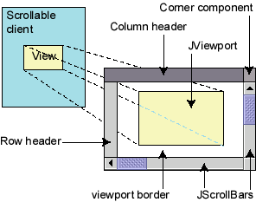
Decorator example: GUI
normal GUI components don't have scroll bars
JScrollPane is a container with scroll bars to which you can add any component to make it scrollable
// JScrollPane decorates GUI components
JTextArea area = new JTextArea(20, 30);
JScrollPane scrollPane =
new JScrollPane(area);
contentPane.add(scrollPane);

Slide 8
When to Use Decorator Pattern
  To add responsibilities to individual objects dynamically without affecting other objects.
  When extension by subclassing is impractical. Sometimes a large number of independent extensions are possible and would produce an explosion of subclasses to support every combination. Or a class definition may be hidden or otherwise unavailable for subclassing.

Slide 9
Decorator Example
Component
Each component can be used on its own, or wrapped by a decorator.
// Component
public abstract class Breakfast {
String description = "Unknown Breakfast";
public String getDescription() {
return description;
}
public abstract double cost();
}

Slide 10
Decorator Example
ConcreteComponent
The ConcreteComponent is the object we’re going to dynamically add new behavior to. It extends Component.
// Concrete Component
public class Dosa extends Breakfast{
public Dosa() {
description = "Dosa";
}
public double cost(){
return 12.50;
}
}
//Concrete Component
public class Idli extends Breakfast{
public Idli() {
description = "Idli";
}
public double cost(){
return 10.50;
}
}

Slide 11
Decorator Example
Decorator
Each decorator HAS-A (wraps) a component, which means the decorator has an instance variable that holds a reference to a component.
Decorators implement the same interface or abstract class as the component they are going to decorate.
// Decorator
public abstract class Decorator extends Breakfast{
public abstract String getDescription();
}

Slide 12
Decorator Example
ConcreteDecorator:
The ConcreteDecorator has an instance variable for the thing it decorates (the Component the Decorator wraps).
// Concrete Decorator
public class MasalaDosaDecorator extends Decorator{
Breakfast breakfast;
public MasalaDosaDecorator(Breakfast breakfast){
this.breakfast = breakfast;
}
public String getDescription(){
return breakfast.getDescription()+" ,its MasalaDosa";
}
public double cost(){
return breakfast.cost() + 5.50;
}
}

Slide 13
Decorator Example
//Concrete Decorator
public class OnionDosaDecorator extends Decorator{
Breakfast breakfast;
public OnionDosaDecorator(Breakfast breakfast){
this.breakfast = breakfast;
}
public String getDescription(){
return breakfast.getDescription()+" , its OnionDosa";
}
public double cost(){
return breakfast.cost() + 3.50;
}
}

Slide 14
Decorator Example
Now its time to order Dosa.
public class BreakfastMenu {
public static void main(String[] args) {
// without adding decorators
Breakfast menu1 = new Dosa();
System.out.println(menu1.getDescription() +" Rs. "+menu1.cost());
//adding decorators
Breakfast menu2 = new MasalaDosaDecorator(new OnionDosaDecorator(new Dosa()));
System.out.println(menu2.getDescription() +" Rs. "+menu2.cost());
Breakfast menu3 = new MasalaDosaDecorator(new Dosa());
System.out.println(menu3.getDescription() +" Rs. "+menu3.cost());
}
}

Slide 15
Decorator Example
Output:
Dosa Rs. 12.5
Dosa, its OnionDosa, its MasalaDosa Rs. 21.5
Dosa, its MasalaDosa Rs. 18.0

Slide 16
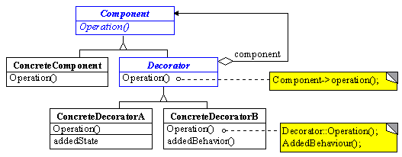
Structure

Slide 17
Participants
Component: defines the interface for objects that can have responsibilities added to them dynamically
Decorator: maintains a reference to a Component object and defines an interface that conforms to Component's interface
ConcreteComponent: defines an object to which additional responsibilities can be attached
ConcreteDecorator: adds responsibilities to the component

Slide 18
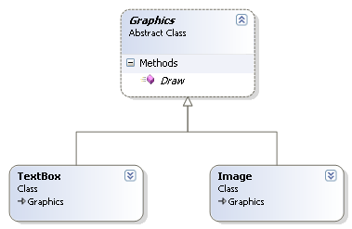
Graphics Example

Slide 19
Graphics Example
We would like to add a new behaviour to our Image / TextBox so that it shows a Border as well.
One way is to use inheritence and place a ShowBorder() method in the base class or Image class. This would solve our problem but simultaneously it will alter the behaviour of all Image objects which is not desirable.
We would like to add Border/Shadow behavior only to objects we want. the solution lies with the decorator pattern.

Slide 20
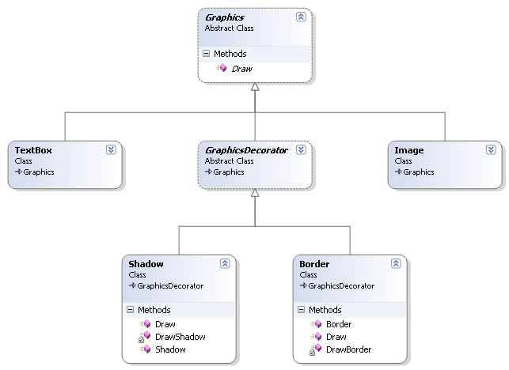
Graphics Example

Slide 21
CHARACTERISTICS OF A DECORATOR
The Decorator object is designed to have the same interface as the underlying object. This allows a client object to interact with the Decorator object in exactly the same manner as it would with the underlying actual object.
The Decorator object contains a reference to the actual object.
The Decorator object receives all requests (calls) from a client. It in turn forwards these calls to the underlying object.
The Decorator object adds some additional functionality before or after forwarding requests to the underlying object. This ensures that the additional functionality can be added to a given object externally at runtime without modifying its structure.

Slide 22
Decorator Pattern | Inheritance
Used to extend the functionality of particular object. Does not require subclassing. Dynamic. Runtime assignment of responsibilities. More flexible. | Used to extend the functionality of a class of objects. Requires subclassing. Static. Compile time assignment of responsibilities. Less flexible.

Slide 23
Decorator Pattern | Inheritance
Prevents the proliferation of subclasses leading to less complexity and confusion. Possible to have different decorator objects for a given object simultaneously. A client can choose what capabilities it wants by sending messages to an appropriate decorator. | Could lead to numerous subclasses, exploding class hierarchy on specific occasions. Having subclasses for all possible combinations of additional capabilities, which clients expect out of a given class, could lead to a proliferation of subclasses.

Slide 24
Example – Message Logging Utility
a Logger interface and two of its implementers — FileLogger and ConsoleLogger, to log messages to a file and to the screen, respectively.
Two small features that clients would like to have:
  Transform an incoming message to an HTML document.
  Apply a simple encryption by transposition logic on an incoming message.

Slide 25
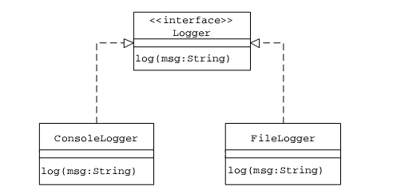
Logging Utility Class Hierarchy

Slide 26
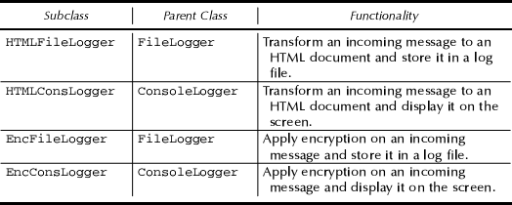
Subclasses Of FileLogger and ConsoleLogger

Slide 27
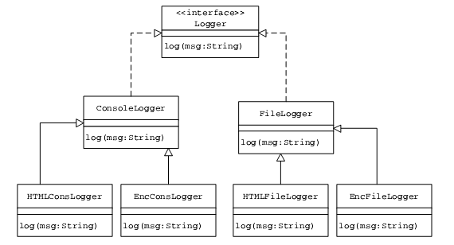
The Resulting Class Hierarchy after Applying Inheritance to Add the New
Functionality

Slide 28
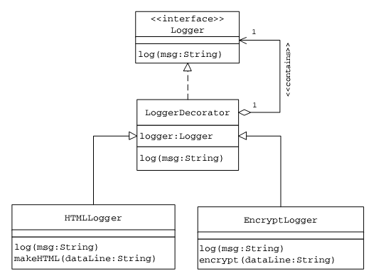
The Decorator Class Structure for the Logging Utility to Add the New
Functionality

Slide 29
Decorator Pattern
Applying the Decorator pattern, let us define a default root decorator
LoggerDecorator for the message logging utility with the following characteristics:
  The LoggerDecorator contains a reference to a Logger instance. This reference points to a Logger object it wraps.
  The LoggerDecorator implements the Logger interface and provides the basic default implementation for the log method, where it simply forwards an incoming call to the Logger object it wraps. Every subclass of the LoggerDecorator is hence guaranteed to have the log method defined in it.

Slide 30
CONCRETE LOGGER DECORATORS
HTMLLogger: It overrides the default implementation of the log method. Inside the log method, this decorator transforms an incoming message to an HTML document and then sends it to the Logger instance it contains for logging.
EncryptLogger: Similar to the HTMLLogger, the EncryptLogger overrides the log method. Inside the log method, the EncryptLogger implements simple encryption logic by shifting characters to the right by one position and sends it to the Logger instance it contains for logging.

Slide 31
Client Object needs to
Create an appropriate Logger instance (FileLogger/ConsoleLogger) using the LoggerFactory factory method.
Create an appropriate LoggerDecorator instance by passing the Logger instance created in Step 1 as an argument to its constructor.
Invoke methods on the LoggerDecorator instance as it would on the Logger instance.

Slide 32
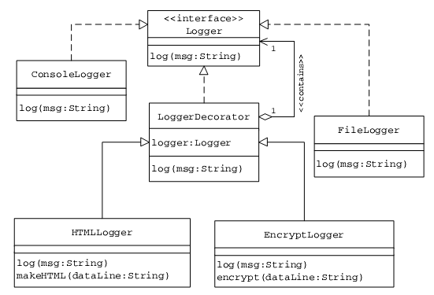
Association between Different Logger Classes and Logger Decorators

